Slide 1
The Approach
Start with a frontier that contains the initial state
Repeat:
- if the frontier is empty, then no solution
- Remove a node from the frontier
- if node contains goal state, return the solutions
- Expand the node and resulting node to the frontier

Slide 2
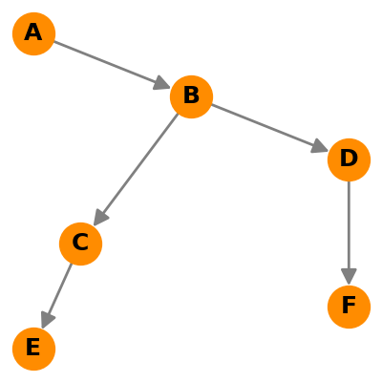
Example: Find a path from A to E

Slide 3
Example: Find a path from A to E
Frontier
C
B
A
D
E
F
Is this the Goal State?
Start with a frontier that contains the initial state
Repeat:
- if the frontier is empty, then no solution
- Remove a node from the frontier
- if node contains goal state, return the solutions
- Expand the node and resulting node to the frontier
is the solution
D
E
A
B
C

Slide 4
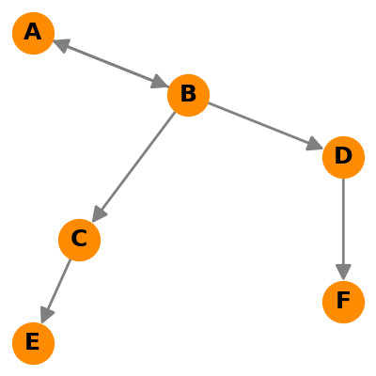
The Problem of this Approach Example: Find a path from A to E
Frontier
A
C
D
B
B
A

Slide 5
Revised Approach
Start with a frontier that contains the initial state
Start with an empty explored set
Repeat:
- if the frontier is empty, then no solution.
- Remove a node from the frontier.
- if node contains goal state, return the solutions.
- Add the node to the explored set.
- Expand the node, add resulting nodes to the frontier, if they aren’t already in the frontier or the explored set.

Slide 6
How to Remove from the Froniter
Stack:- Last in First-out data type
Queue:- First-in First-out data type

Slide 7
Depth-First Search Algorithm (stack datatype) Example: Find a path from A to E
Frontier
A
D
C
F
E
B
E
Explored set
A
B
D
F
C
Start with a frontier that contains the initial state
Start with an empty explored set
Repeat:
- if the frontier is empty, then no solution.
- Remove a node from the frontier (Last-in First-out data type).
- if node contains goal state, return the solutions.
- Add the node to the explored set.
- Expand the node, add resulting nodes to the frontier, if they aren’t already in the frontier or the explored set.

Slide 8
Breath-First Search Algorithm (Queue datatype) Example: Find a path from A to E
Frontier
B
D
E
F
C
A
E
Explored set
A
B
C
D
Start with a frontier that contains the initial state
Start with an empty explored set
Repeat:
- if the frontier is empty, then no solution.
- Remove a node from the frontier (First-in First-out data type).
- if node contains goal state, return the solutions.
- Add the node to the explored set.
- Expand the node, add resulting nodes to the frontier, if they aren’t already in the frontier or the explored set.

Slide 9
Practical Examples

Slide 10
Depth-First Search Algorithm

Slide 11
Big Question
Will it always work? ➔ YES, If the solution is finite.
Is it the best solution? Not in all case.

Slide 12
Depth-First Search Algorithm

Slide 13
Breadth-First Search Algorithm

Slide 14
Breadth-First Search Algorithm

Slide 15
Need for a More Intelligent Search Algorithm
How do humans solve this?

Slide 16
Types of Search Algorithms
Uninformed Search Algorithms
Informed Search Algorithms

Slide 17

Uninformed Search Algorithms
This is a search strategy that uses no problem-specific knowledge.
An uninformed search algorithm is given no clue about how close a state is to the goal(s).

Slide 18
Other Uninformed Search Algorithms
Depth-limited Algorithms
Iterative Deepening Search Algorithms
Uniform-cost Search (Dijkstra) Algorithms
Bidirectional search

Slide 19
Informed Search Algorithms (Heuristic)
This is a search strategy that uses problem-specific knowledge to find solutions more efficiently.

Slide 20
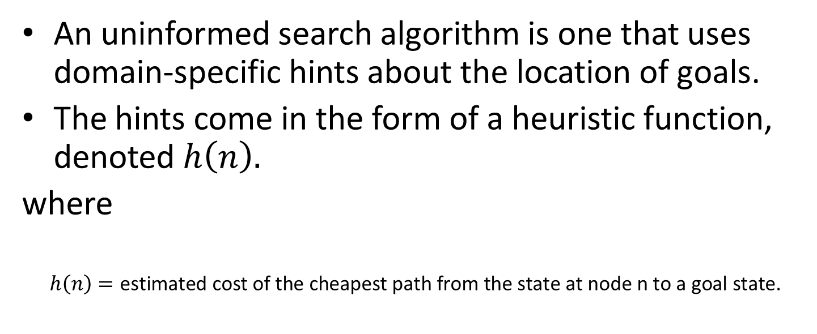
Informed Search Algorithms (Heuristic)
An uninformed search algorithm is one that uses domain-specific hints about the location of goals.
The hints come in the form of a heuristic function, denoted $h\left(n\right).$
where
$$h\left(n\right)=\text{estimated} \text{cost} \text{of} \text{the} \text{cheapest} \text{path} \text{from} \text{the} \text{state} \text{at} \text{node} \text{n} \text{to} \text{a} \text{goal} \text{state}\text{.}$$

Slide 21
Heuristic Function
Manhattan Distance
B
A

Slide 22
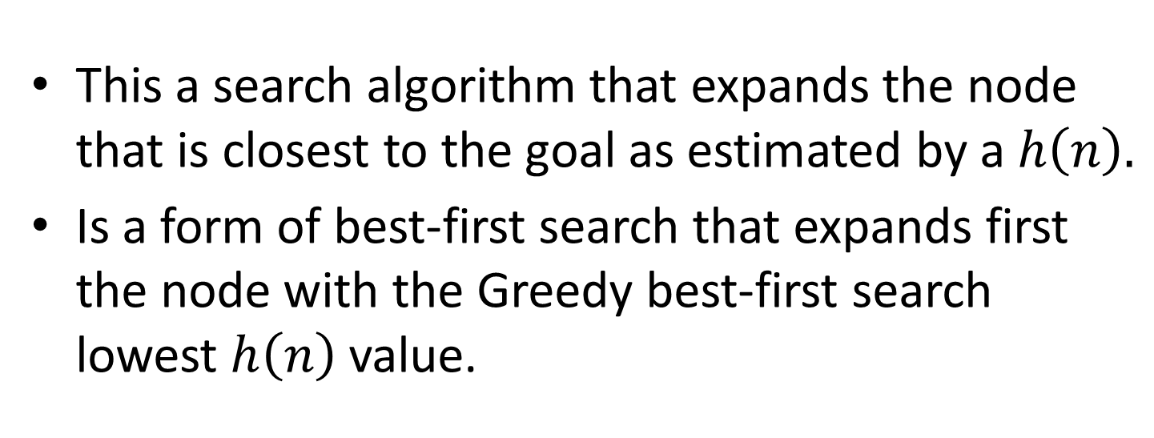
Greedy Best-First Search Algorithm
This a search algorithm that expands the node that is closest to the goal as estimated by a $h\left(n\right).$
Is a form of best-first search that expands first the node with the Greedy best-first search lowest $h\left(n\right)$ value.

Slide 23
Greedy Best-First Search Algorithm
Manhattan Distance
11 |  | 9 |  | 7 |  |  |  | 3 | 2
12 |  | 10 |  | 8 | 7 | 6 |  | 4 |  |  | 1
13 | 12 | 11 |  | 9 |  | 7 | 6 | 5 |  |  | 2
 | 13 |  |  | 10 |  | 8 |  | 6 |  |  | 3
 | 14 | 13 | 12 | 11 |  | 9 |  | 7 | 6 | 5 | 4
 |  |  | 13 |  |  | 10
 | 16 | 15 | 14 |  |  | 11 | 10 | 9 | 8 | 7 | 6

Slide 24
Big Question Again Is it the best solution?

Slide 25
Greedy Best-First Search Algorithm
 | 10 | 9 | 8 | 7 | 6 | 5 | 4 | 3 | 2 | 1
 | 11 |  |  |  |  |  |  |  |  |  | 1
 | 12 |  | 10 | 9 | 8 | 7 | 6 | 5 | 4 |  | 2
 | 13 |  | 11 |  |  |  |  |  | 5 |  | 3
 | 14 | 13 | 12 |  | 10 | 9 | 8 | 7 | 6 |  | 4
 |  |  | 13 |  | 11 |  |  |  |  |  | 5
 | 16 | 15 | 14 |  | 12 | 11 | 10 | 9 | 8 | 7 | 6

Slide 26
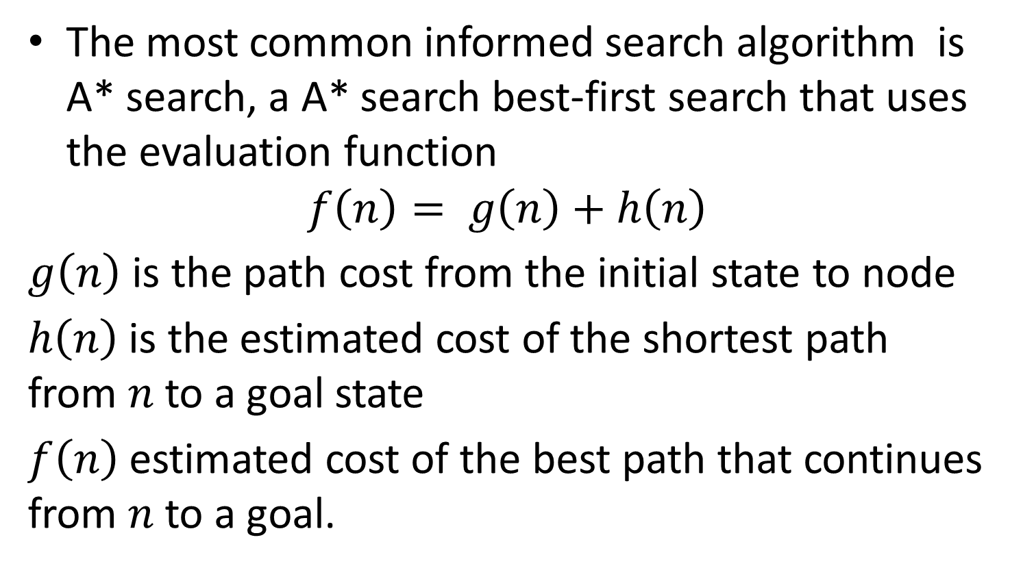
A* Search Algorithm
The most common informed search algorithm is A* search, a A* search best-first search that uses the evaluation function
$$f\left(n\right)= g\left(n\right)+h\left(n\right)$$
$g\left(n\right)$ is the path cost from the initial state to node
$h\left(n\right)$is the estimated cost of the shortest path from $n$to a goal state
$f\left(n\right)$estimated cost of the best path that continues from $n$ to a goal.

Slide 27
A* Search Algorithm
 | 10 | 9 | 8 | 7 | 6 | 5 | 4 | 3 | 2 | 1
 | 11 |  |  |  |  |  |  |  |  |  | 1
 | 12 |  | 10 | 9 | 8 | 7 | 6 | 5 | 4 |  | 2
 | 13 |  | 11 |  |  |  |  |  | 5 |  | 3
 | 14 | 13 | 12 |  | 10 | 9 | 8 | 7 | 6 |  | 4
 |  |  | 13 |  | 11 |  |  |  |  |  | 5
 | 16 | 15 | 14 |  | 12 | 11 | 10 | 9 | 8 | 7 | 6
11+10
12+9
13+8
14+7
15+6
16+5
17+4
18+3
19+2
20+1
10+11
9+12
7+10
8+9
9+8
10+7
11+6
12+5
13+4
8+13
6+11
14+5
7+14
6+13
5+12
15+6
4+13
1+16
2+15
3+14

Slide 28
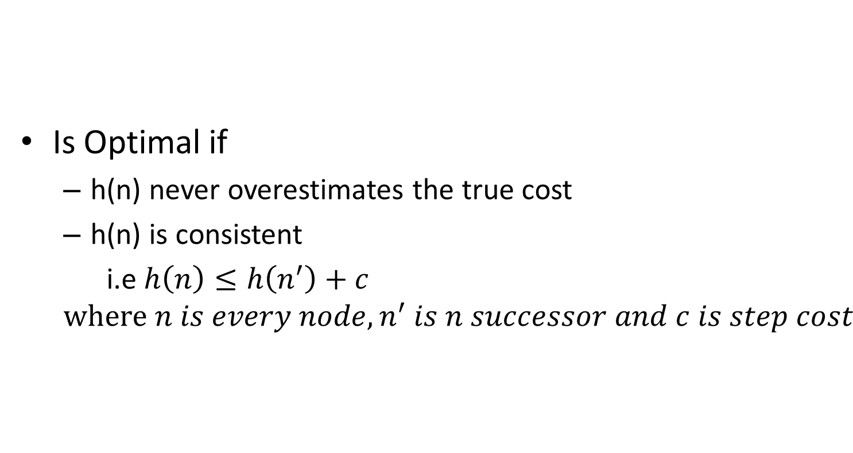
A* Search Algorithm
Is Optimal if
h(n) never overestimates the true cost
h(n) is consistent
i.e $h\left(n\right)≤h\left(n^{′}\right)+c$
$$where n is every node,n^{′} is n successor and c is step cost$$

